Slide 1

Integrating Serious Content into Serious Games
William Ryan
wryan@ithaca.edu
Dennis Charsky
dcharsky@ithaca.edu
Department of
Strategic Communication
Notes:
* Names
Title
Wanted to learn more about this process: have courses in games design, and in instructional design with games—but often this process could be bridged better between
We teach such a course trying to bridge the two
We purposed to learn more about how serious game design actually happens

Slide 2
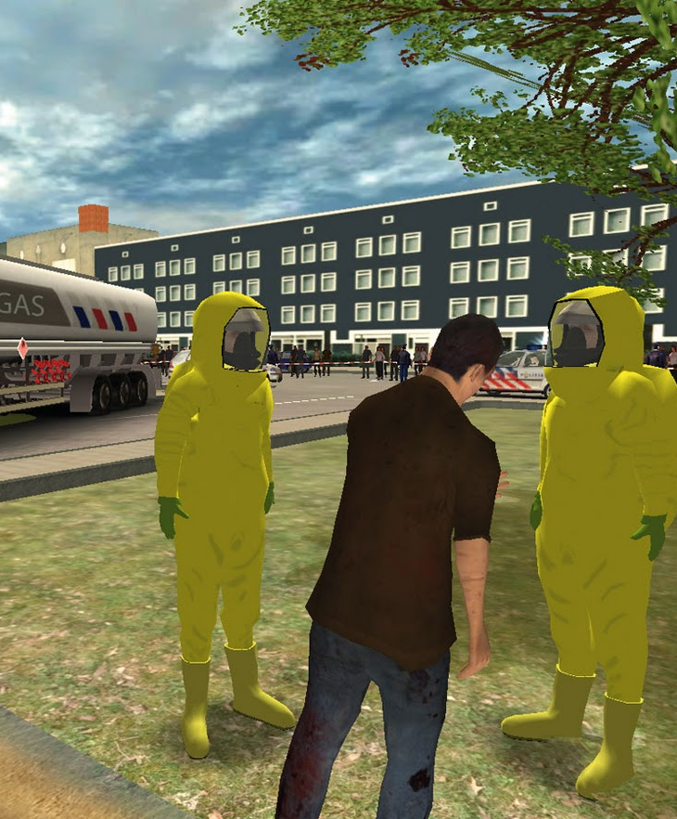
Allowing “Wrong” Decisions
RescueSim,
VSTEP
Designers design interesting decisions
  Unless the client doesn’t want them to.
Not just about engagement only or learning only
Notes:
As far as games go, think about designing a serious game—like RescueSim on the right
The designer wants to make decisions as easy and engaging as possible. As Chris Crawford has asserted, what makes games interesting are decisions that are interesting.
What if your client (who is paying for the game to be designed) doesn’t want you to allow the user to make decisions that could jeopardize the lives of everyone.
What if the client wants to limit decision making, even when it might make the game more compelling
This has happened to at least one of the participants we interviewed
Not just about engagement, not just about learning, sometimes its about more

Slide 3
Instructional Design & Serious Games
Content integration: [2]
  Endogenous
  Exogenous
Theoretical approaches:
  Gagne’s Events of Instruction [1]
  Keller’s ARCS motivational model [1]
  Bloom’s Taxonomy [1]
  Learning by doing [6]
  Scenario-based Design [4]
  Problem based Learning [3]
Notes:
In our evaluation of serious game literature, we wanted to see evidence of understanding the practice of taking some instructional content and turning it into a feasible game
Most of the research we found, focused on the screen. We learned of two forms of content integration, but a number of different theoretical approaches, which allows one to “structure” the game
In all cases, these are “whys” separated from the “hows” of game design

Slide 4
Instructional Design & Serious Games
Much of the literature from instructional design perspective
Gap between theory and practice
What do good serious game designers do?
Notes:
We saw a gap between theory and practice in understanding how to create a serious game
We wanted to understand not just what is the ideal, but how is it done at all
Future research can take the next step to look at ways of improving this process of serious game design

Slide 5
Study Method
Semi-structured Interview
  Focus: integration of serious game content into games
  Conducted remotely via Skype
Session time: 30-45 minutes
11 Respondents
  gender: 7 male, 4 female
  region:
  5 northeast,
  4 midwest,
  2 west coast
  background:
  3 game design,
  5 instruct. design,
  3 mixed
Notes:
Our study relied on interview methodology with a number of respondents who had a background working in serious game design. We selected people from all different areas in the US and selected a diverse group of backgrounds as you can see.
Because we drew from such a spread out audience, we conducted interviews remotely via Skype for sessions between 30 & 45 minutes

Slide 6
Question Sheet
Demographic/Psychographic
Please identify your gender.
On a scale of 1 to 7, how do you feel about this statement:
Games are a leisure activity.
Games are a communicative activity.
Have you played these genres?
Action , Adventure, Shooter…
What degrees have you earned?
What are your job responsibilities?
Do you have formal serious games training?
In what ways have you participated in a serious game design?
Integrating Content
How might game elements interfere with training goals?
How might the training method interfere with an enjoyable game?
How can you determine what game genre to use?
How can one integrate training goals with game elements?
What skill set is required for this integration?
How would you determine if a serious game was successful?
Notes:
Questions we asked came from the list you see here, but we would often deviate from this as certain lines of questioning would becoming interesting.
We asked a number of demographic and psychographic questions to get an idea of who we were talking to and their background, as well as to give some context to games they design they might comment on in the second session.
The integrating content section of questions asked about training goals and game elements separately, how to integrate them, how to determine a high level issue such as game genre, how to evaluate success, and what is needed to build these games.

Slide 7
Findings
Designing Representations & Mechanics
Balance Engagement & Learning Objectives
Realism & Authenticity
Evaluation
Exogenous Factors
Skillsets of Serious Game Designers
Notes:
* A number of areas arose out of the interview that we found interesting and worthy of sharing, they are…

Slide 8
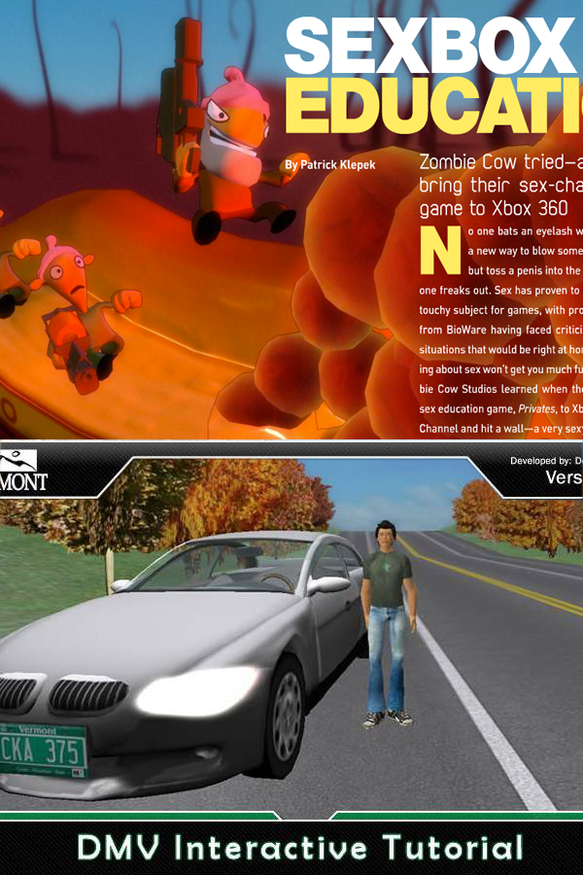
Designing Representation & Mechanics
Privates,
Zombie Cow
Pacing
  Level = practice,
  boss = summary
Repetition
Content Granularity
  Abstraction — deep learning
Disruptive Evaluation
Distractors
DriveVermont,
State of Vermont
Mechanics
Balance
Realism
Evaluation
Factors
Skillset
Notes:
We learned about aspects needing addressed as any kind of learning content is brought into games and represented through games.
These factors helped to describe how learning can be retained in such games.
Pacing was an important aspect, not just for game engagement (don’t overwhelm the player), but to give learners opportunities to digest new content they needed as well.
This will be visible in any effective game, but it must be consciously designed just as play balancing is designed.
One designer mentioned using level design as practice and boss “fights” as a way to summarize and consolidate learning
Repetition is an important concept in any learning environment.
Memorization requires rote learning, but even higher level functions such as application and synthesis require repetition in similar circumstances before a learner can be confident in what they have learned.
A number of designers mentioned this as an important factor
The granularity of content dealt with how specific the content to be integrated needed to be represented
This relates with authenticity/realism later as well, but from a representation standpoint, the designer needed to decide what exactly needs to be represented from the real situation and how
This also led to discussions on abstraction. Abstraction had much to do with the discussion of exogenous and endogenous games. How deeply is the content represented—surface level couched in games, or do the learning concepts tie in deeply into the core mechanisms in the game.
There were two other issues related to representation: the nature of evaluation (is it inside the game or outside) and game elements distracting from the true purpose of the game.
In both issues, designers need to make sure they focus on goals of the design in these regards—it can be easy to get caught up with either
Evaluation in particular is an issue researchers in immersion have dealt with for a long time.

Slide 9
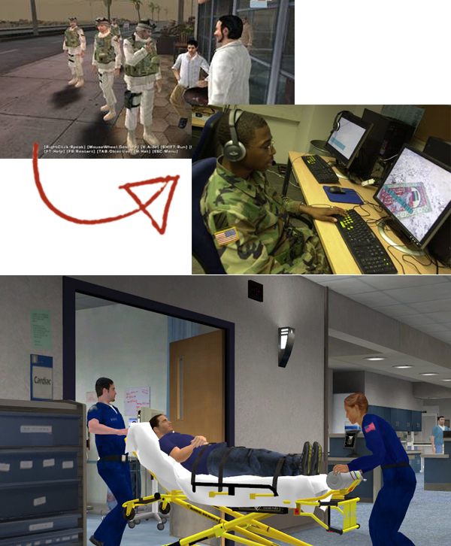
Balance Engagement & Learning Objectives
Balance of:
promotion/incentives
engagement/learning
  design time
  training time
Tactical Iraqi,
Tactical Language Training
Pulse!!,
Interaction Healthcare
Mechanics
Balance
Realism
Evaluation
Factors
Skillset
Notes:
Dealing with balance, there were three main aspects that needed balance. First:
Designers need to acknowledge that they hold the key to meaning in the game
They (with the client) choose what aspects of a situation are promoted and which do not
They also control how incentives work, when to provide them and how they should be (a cut-scene, puzzle, interesting game play, stunning visual design)
One participant said these incentives are often the “selling point” to the trainee, but don’t represent the main content.
With regard to engagement features and learning features.
First, designers have only a certain amount of resources and time
Even though they can get caught up in adding “cool” aspects to a game, or “fun” aspects of a game—ultimately, the game serves other purposes than just being entertaining
They need to prioritize based on higher level of goals.
Second, on the user time:
Serious games depart greatly from traditional games, often times those playing the games only have a specific set amount of times devoted to training
This game has to fit within that time constraint--having people sucked into the game wanting to continue to play might serve the trainee, but not the trainer.
This also means anything in the game needs to be coordinated with other content

Slide 10
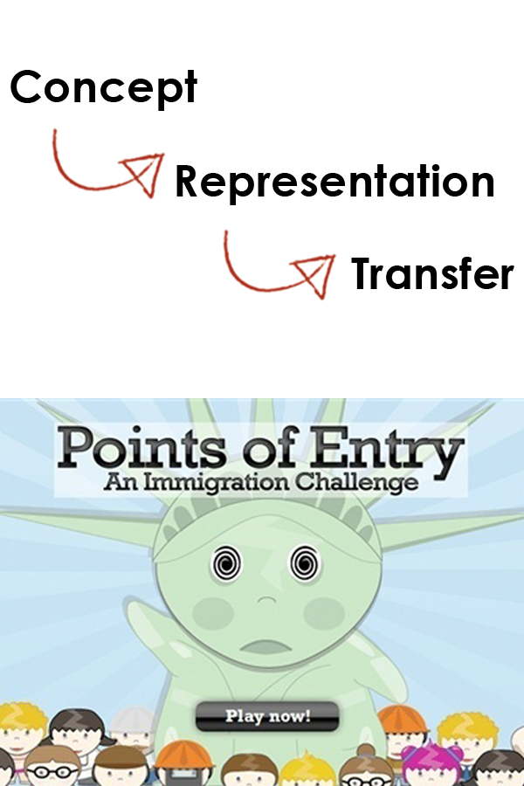
Realism & Authenticity
Authenticity important for learning and engagement
  Meaning beyond magic circle
Decision Importance
Misrepresentation
  Cannot represent everything — Abstractions
Persuasive Games
Mechanics
Balance
Realism
Evaluation
Factors
Skillset
Notes:
In games, realism (particularly photorealism) is often the ideal. In serious games, it is often the imperative.
Serious games need to have meaning beyond the game itself, or the game was not successful.
In serious games, photorealism may be a goal, but decision realism is often the level of fidelity required for most clients.
Misrepresentations of the real situation are problematic
But there is a paradox here, games and simulations can’t represent everything
Sometimes, communicating this to a client is the designers responsibility
One participant and one paper we mention in our paper talk about this situation where the client is pushing for creating the game more realistic even at the expense of making the game more enjoyable.

Slide 11
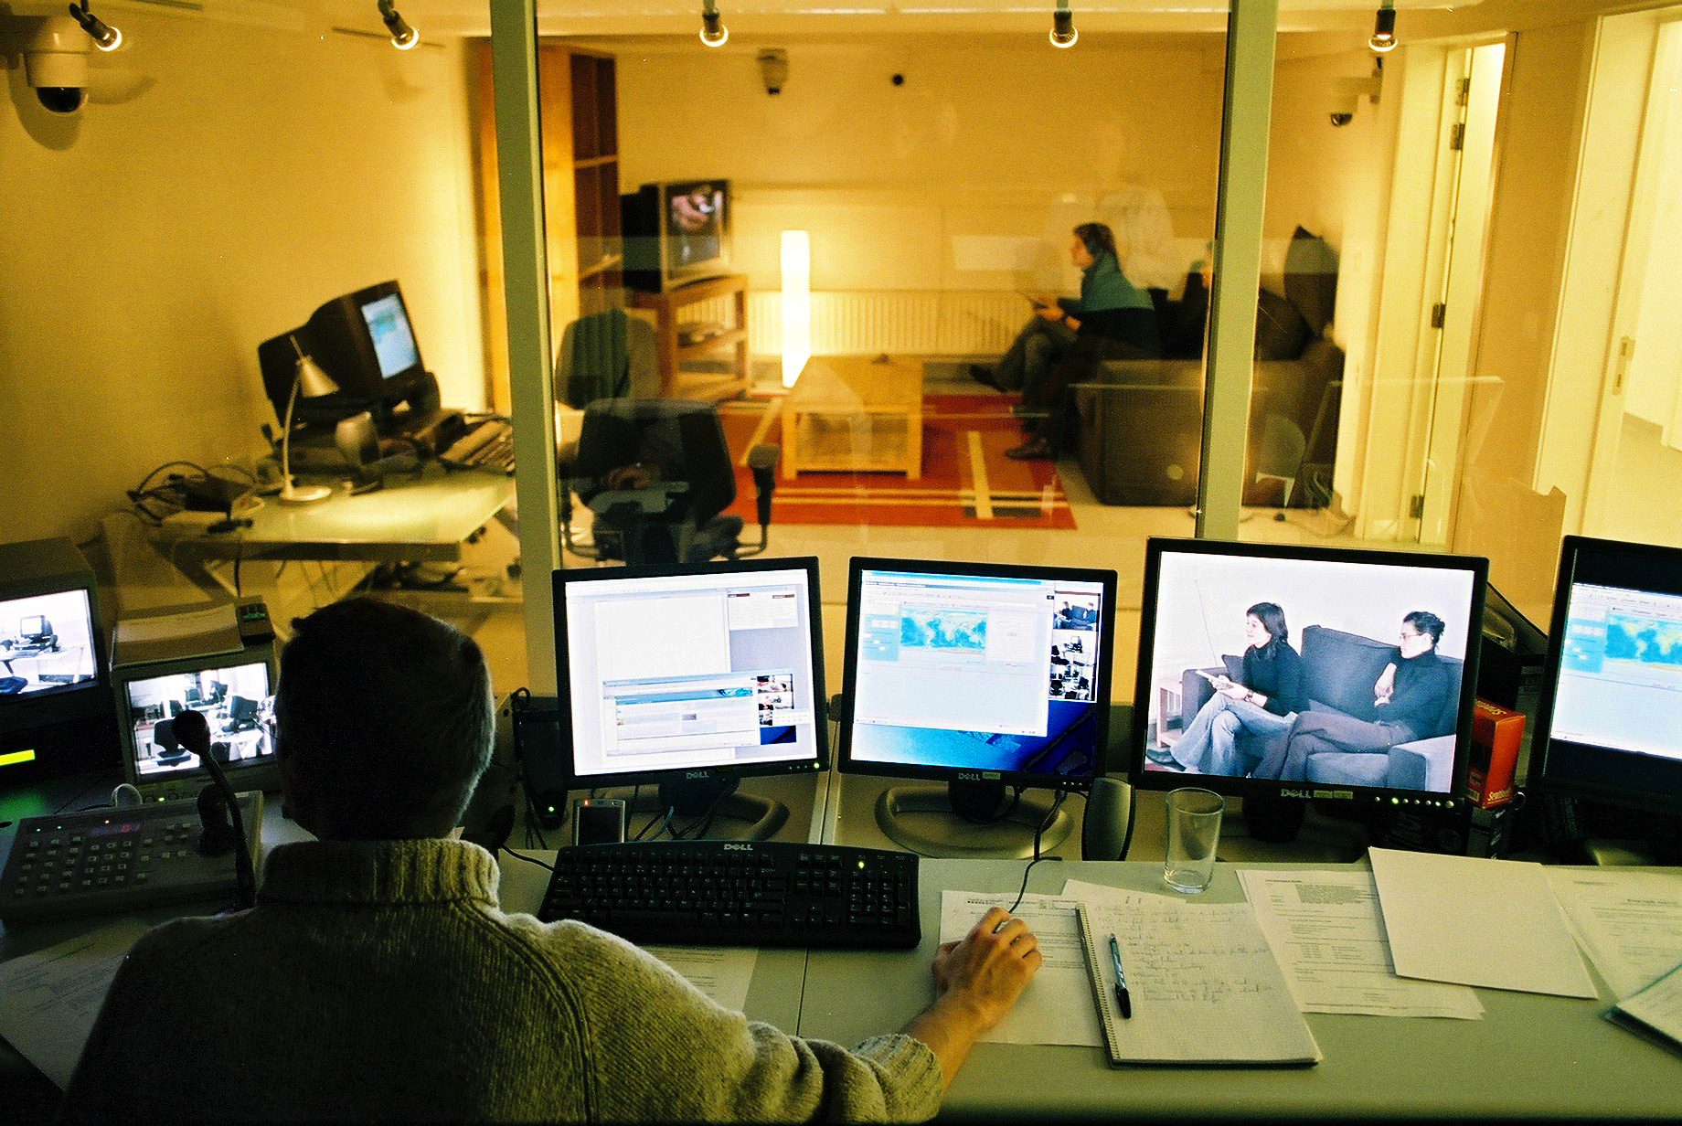
Evaluation
Evaluation of:
Learning
Engagement
Organizational Factors
Mechanics
Balance
Realism
Evaluation
Factors
Skillset
Notes:
There were three levels of evaluation mentioned in the study:
First had to do with learning: while there were often grand goals of studying the learning
Rarely did designers do anything more than a pre-test, post-test quiz of main concepts.
Expense was often mentioned as the factor here
Engagement was the second
Here a number of participants mentioned everything from
testing cognitive factors of engagement
Asking people if they enjoyed the games
Play testing one self
Looking at sales or play figures once the game is released
Finally, there were two promotional/persuasive factors involved in serious game creation
Stakeholder buy-in: early in the process, but could also be for game decisions and directions
Part of negotiation process
Return on Investment
Games are an expensive alternative, what is their impact.

Slide 12

Exogenous Factors
Role of the client
Threat of AAA games
Distinguish player from buyer
Mechanics
Balance
Realism
Evaluation
Factors
Skillset
Notes:
There were a number of external factors as well:
The role of the publisher in traditional games is often morphed into the role of the client
The issue may be here that the client may be less knowledgeable about the game design process than a publisher
Can be a double edge sword
As participants mentioned, even when one disagrees with a client though, they still need to implement the client’s vision.
Client may be motivated by learning, but may also be concerned with other factors: sales, retention
A number of participants mentioned the threat of AAA games with amazing graphics—such as the example of Killzone on the right
This shapes certain players expectations of what all games should be like
Puts pressure on designers.
Lastly, designers explained that often times certain aspects needed to be designed for an audience other than players: the buyers
Boxing, website, promotional materials
Corporate setting, classroom educational setting

Slide 13
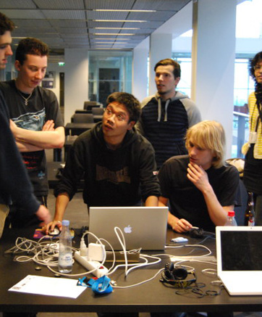
Skillsets of Serious Game Designers
Game Knowledge
Knowing Audience
Knowing about Fun
Pedagogy/ Instructional Design
  Learning Game/Media Design
Mechanics
Balance
Realism
Evaluation
Factors
Skillset
Notes:
* Lastly, participants mentioned a number of interesting skillsets, listed here.

Slide 14

Implications
Designers do not proceed from theory.
Need models for applying theory.
What does game design bring instructional design?
Theories-in-action
Donald Schön
[5]
Notes:
The implications from this research are that designers do not operate from models, but use them when they become useful.
This is more akin to Schon’s “theories-in-action” concept, where designers do design and only use theory when it serves the purpose of that design
We need more models describing the application of theory.
We might also ask, what might game design bring to instructional design as another perspective on this triangle of serious game design practice.

Slide 15
Key Points
Integration about balancing
  player engagement
  game promotion
  organizational issues
  AS WELL AS learning
Integration techniques
  Pacing
  Repetition
  Visual Design
  Abstraction
Be explicit about goals
Design is about deciding!

Slide 16
Questions?

Slide 17
References
Gunter, G. A., Kenny, R. F., & Vick, E. H. (2006). A case for a formal design paradigm for serious games. Journ. Inter. Digital Media and Arts Association, 3(1), 93-105.
Habgood, M. P. J. (2007). The Effective Integration of Digital Games and Learning Content. (Unpublished doctoral dissertation). University of Nottingham, Nottingham, UK.
Hong, W., & Van Eck, R. (2010). Aligning problem solving and gameplay. In R. Van Eck (Ed.), Interdisciplinary Models and Tools for Serious Games (pp. 227-264). Hershey, PA: IGI Global.
Marsh, T. (2010). Activity-Based Scenario Design, Development and Assessment in Serious Games. In R. Van Eck (Ed.), Gaming and Cognition: Theories and Practice from the Learning Sciences (pp. 152-168). Hershey, PA: IGI Global.
Schön, D. (1983). The Reflective Practitioner: How Professional Think in Action. New York: Basic Books.
Squire, K. (2006). From content to context: Videogames as designed experience. Educational Researcher, 35(8), 19-29.

Slide 18
Image Links
http://v021o.popscreen.com/eGh0cTRmMTI=_o_foratv-technology-video-gaming-grows-up-ian-bogost-on-.jpg
http://3.bp.blogspot.com/_Ss_rLDyRQCk/SxKofkxIaSI/AAAAAAAAMWc/7m4L9TSCOKY/s1600/Serious-Games+193.jpg
http://www.videogameologists.com/wp-content/uploads/2011/10/Game-designer-wallpaper.jpg
http://www.scs.ryerson.ca/~cps613/References/UsabilityEngineering/stationair-usability-lab.jpg
http://www.john-lauckner.com/wp-content/uploads/2010/10/Screen-shot-2010-10-07-at-7.39.02-PM.png
http://4.bp.blogspot.com/_Ss_rLDyRQCk/TTCT-LIsnKI/AAAAAAAAOR4/zLVYU1h1aY4/s1600/800+Serious-Games.jpg
http://4.bp.blogspot.com/_Ss_rLDyRQCk/TNG7sUqf1MI/AAAAAAAAOHg/yTJcESil_O8/s1600/690+Serious-Games.jpg
http://www.uni-learning.com/images/serious-games.jpg
http://www.happynews.com/showImage.aspx?fn=12182008/serious-games-designed-learning-training-simulation-fun.jpg&catid=8
http://3.bp.blogspot.com/_Ss_rLDyRQCk/SS6tukHUvyI/AAAAAAAAHmo/SFh8UEfhyno/s400/Army1.jpg
http://www.therapy4mindbody.com/wp-content/uploads/2010/01/HandDrawnArrow.jpg
http://metalarcade.net/wp-content/uploads/2013/02/Killzone-4-PlayStation-4-City.jpg
http://www.paradigmsi.com/wp-content/uploads/2012/09/Conference-Room-With-TV-420x220.jpg

