Slide 1
Transforming Game Narrative through Social Media: Studying the Mass Effect Universe of Twitter
William Ryan
Ithaca College
wryan@ithaca.edu
Zach Gilson
Ithaca College
zgilson@ithaca.edu

Slide 2
Narrative Engagement
Participatory Narrative
  Involve audience in telling story
  Game designers looking for ways to reduce linearity in story
  Fan Fiction: Social Media
Twitter
  How does Twitter transform the narrative of a game? designer’s relationship to audience? fans relationships to each other?
Notes:
Participatory narrative is a co-constructive process, it is one means by which designers create non-linearity in a storyline. It requires a different orientation by designers in that designers must release some of the control over the telling of their stories. Once incorporating a participatory approach, a decision is made whether the participatory narrative is separated for each individual or if it is a social process where narratives are shared between all players. Our study is a focus on a particular medium for this shared participatory narrative, we are looking at a particular type of this occurring through social media as fans extend the stories of their favorite games. We are particularly looking at how Twitter accommodates participatory narrative. We wish to look at how Twitter transforms the narrative of a game? We also wish to understand how designer’s relate to their audience in their activities on Twitter. And finally we wish to understand the ways fans relate to each other in this medium.

Slide 3
Procedure
Analyze tweets according to:
  Game references
  Language/style used
  Interaction through Twitter
  Main ideas and themes of tweets
  Authorial intention and context
Sampled 9 accounts of the game Mass Effect for about 13-25 tweets each using:
  Snapbird.org
  MentionMap
  FormSpring
  And any other tools needed
Notes:
To understand this relationship we looked for traditional narratological mechanics, the way these social media narratives related to the original game narrative, and the types of connections authors made with other Twitter accounts. Using a discourse analysis, we analyzed tweets based on the game references they made, language and style used, interaction using the Twitter @ mechanism, main ideas and themes, as well as authorial intention, and context of tweets.
There are a number of game series that have characters represented including Grand Theft Auto, Portal, and Mass Effect. We chose Mass Effect as our focused because of the breadth of characters from the games represented. We choose 9 characters/accounts to analyze drawing about 13-25 from each. We used a number of social media tools to understand the tweets, their relationship, and their context including snapbird, mention map and formspring.

Slide 4
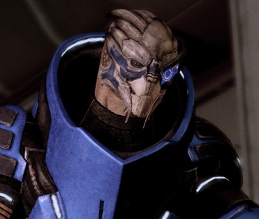
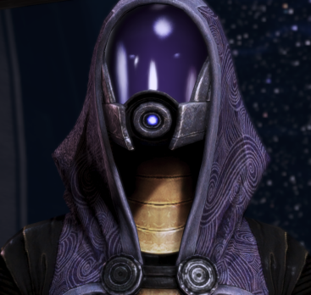
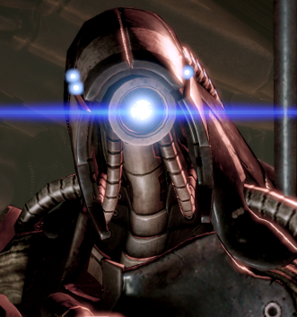
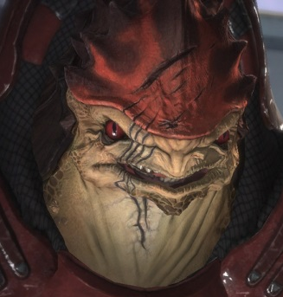
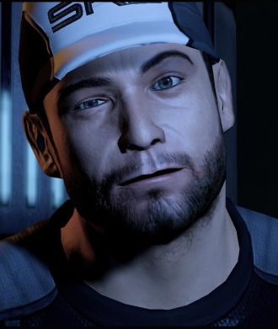
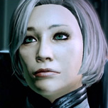
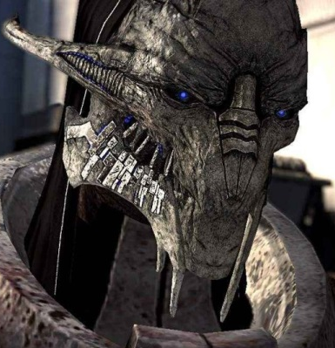
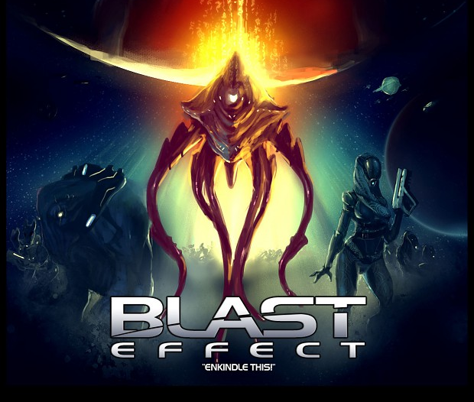
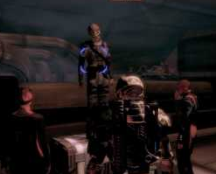
Sampled Accounts
Notes:
There were over 75 characters with a range of diversity in terms of the roles they served in the game. We chose Garrus, Tali, Legion, and Wrex of the main player allies. Joker and Dr. Chakwas as support characters. Saren as an enemy. And, Blasto and Mad Prophet as incidental characters. We avoided Sheppard accounts because we believed the fact that players own choices in the game could influence the way characters role-played the character whereas with these other characters, we could make direct comparisons to how they were written in the games.

Slide 5
Quantitative Findings
Total Tweets 215
  game quotes 7 (3.2%)
  game references 25 (11.7%)
Tense: present 148 (68.8%)
Level of Narration
  dialog only 133 (61.8%)
  narrative voice 61 (28.4%)
Perspective: first-person 191 (88.8%)
Reference
  other character 176 (81.8%)
  non-character 13 (6.0%)
Notes:
In total, we analyzed 215 tweets directly and many more indirectly to understand the context of tweets. There were a number of quantitative findings that provided a good summarization of the characteristics of how authors structured their tweets. First, we see only 3% of tweets were direct quotes from the game (many of them from the the Mad Prophet character (whose in-game dialog demonstrated a great deal of repetition). Further only 11% of tweets actually referenced the game itself. So, the majority of the tweets were about activities outside the game activities. In terms of tense the majority 68% were present and 61% of the tweets were dialog based, as opposed to narration, metadiegesis, or outside the game itself (such as referencing the real world in some way). And finally, 88.8% of the tweets were told from the first-person perspective. This means the focus was on telling an on-going story where each account gave one perspective on that story. Finally, 81.8% of the tweets referenced other characters from the game (or from the game universe), while only 6% were non-game accounts being referenced. Again, this shows that this means accounts responded mostly to other character accounts rather than non-character accounts—focusing on the story being told, more than the characters in and of themselves.

Slide 6
Five Phenomena
Character Psychology & Identity
Twitter as Narrative Medium
Narrative Time
Counterfactuals & Paradoxes
Transmedia
Notes:
There were a number of phenomena we found describing how Twitter was used to tell stories. These include: …
Now, I want to provide an example of each of these as I describe what we found with respect to these phenomena.

Slide 7
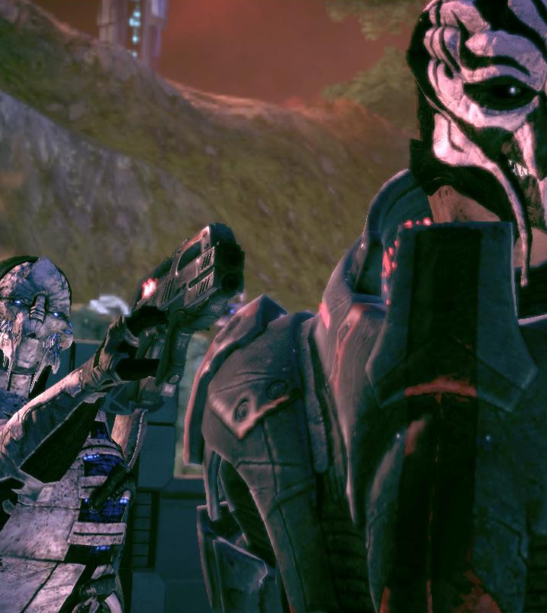
Character Psychology & Identity
SarenArterius @Spectre_Kryik I was influenced. Not controlled. -pause- Sovereign suggested bringing you. I disagreed.
SarenArterius -sneezes- ...
Notes:
Each character was provided in the series with their own unique identity and psychology. The games show who these characters were and how they reacted to a variety of situations.
As roles adopted by fans, these character would need to provide insights to situations both from the game and new situations arising in the joint narrative shared with other role-players. In the first case shown here (read it), Saren an enemy in the game—though re-imagined as an ally in the Twitter universe, is providing insight on his indoctrination.
Traits such as long life spans or conditions such as headache’s suffered by Kaidan’s L2 biotic implants could be used as a source for narrative treatment. Unique styles of speech such as that of Legion’s would need to be incorporated to provide authenticity to the tweet. And, also, creating dialog that makes the character seem more alive such as a sneeze by Saren.
This identity (with a foundation by the game, but supplemented by the author) was the basis for communication, narrative development, and interpersonal relationships in the game.

Slide 8
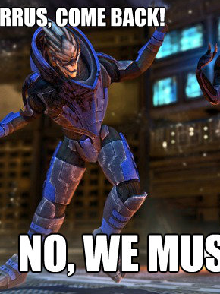
Twitter as Narrative Medium
GarrusVakarian @CDR_JShepard @SarenArterius -grabs Saren's arms and starts making him do the Thriller dance as well, marching alongside him-
Notes:
Twitter as a medium for narrative necessarily changes the way narrative is told for two reasons: the shared social interface and the 140 character limit.
As noted earlier, most of the tweets were dialog based, any narration about on-going activity was shared between characters. Like any improvisation, characters need to adjust to what other character are doing and saying as in this example.

Slide 9
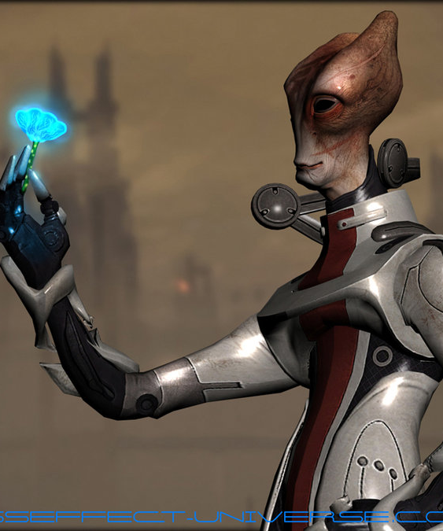
Twitter as Narrative Medium
MordinSolus_PhD @Chakwas Notice. Pathogens released into air supply. ... Addendum. Previous statement was fabrication.
Chakwas @MordinSolus_PhD I haven't the faintest inkling of what I would do without you, Doctor.
MordinSolus_PhD @Chakwas Calculating possibilities. ... ... Suffer from stress.
Notes:
There were three different forms of discourse in this medium: single broadcast messages—similar to Saren’s sneeze two slides ago, message and response where the tweet was intended to provoke response as Mordin’s tweet here, and longer sequences which often included activities and longer term dialog. Activities would often include: drinking together, fighting Reapers forces, playing videos games together, performing character-based work, and activities around developing relationships.
Lastly @ Replies were important in Twitter not only for directing messages at other characters, but also for inclusion in social activities.

Slide 10
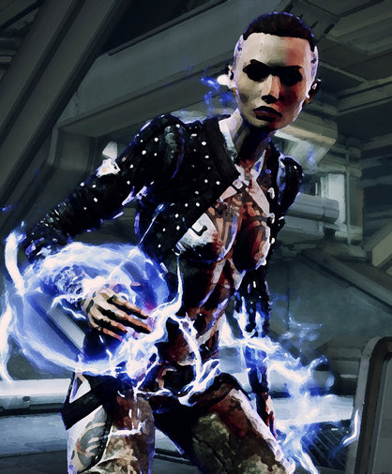
Narrative Time
SarenArterius @BeyondSubject0 -cracks his neck- I've heard you're strong, human. Let's see it.
SarenArterius @CDR_JShepard -growls- I should evict him.
SarenArterius @BeyondSubject0 -mandibles twitch- Very well. -zooms towards her, a strike aimed at her stomach-
SarenArterius @CDR_JShepard What?
SarenArterius @BeyondSubject0 -brings his free arm up, blocking her first with a grunt- Not bad. -steps back, then drops, trying to catch her leg to try -
Notes:
Narrative time operates differently when it comes to Twitter fan fiction. First of all, while the Twitter narrative between characters is told, news games have come out and have restructured the back stories of these characters. One example of this is the relationship between Joker and EDI, at the beginning of ME 3, the two were now in a relationship and so their characters immediately also had to be in a relationship.
Another interesting aspect of narrative time is that time in Twitter doesn’t operate in the same way. The above is an example where Saren fights with Jack simultaneously carrying on an unrelated conversation with Sheppard. Such an example demonstrates the potential for storytelling via Twitter.

Slide 11
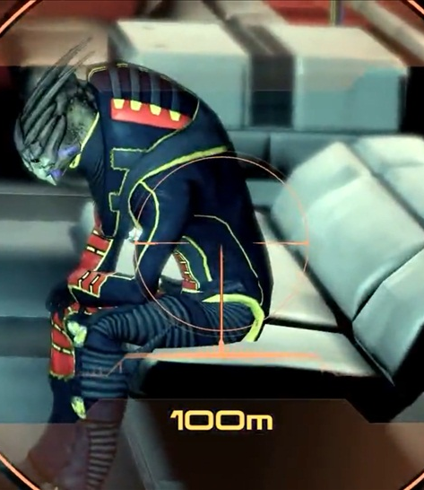
Counterfactuals and Paradoxes
GarrusVakarian @ForgiveSidonis Yeah, I am. You know, if Shepard hadn't been there... -shakes his head, still pacing- You should've told me you were here.
GarrusVakarian @ForgiveSidonis Don't talk to me like we're friends, Sidonis. -practically hisses his name while his mandibles twitch a few more times-
Notes:
Changing identity was understandable as each author has their intention to be shared.
Sometimes, authors would also change the facts of the game. This included things such as allegiances, who was on or not on the Normandy, and relationships with Sheppard. In the above, even whether people had died in the game was often choosen based on whether such a character account existed in Twitter. Here, Garrus confronts a very alive Sidonis—which was one of two possible examples.

Slide 12
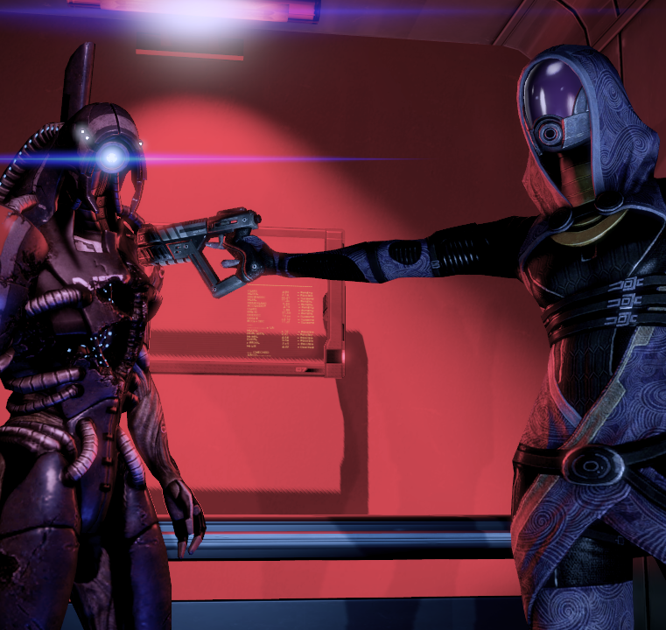
Counterfactuals and Paradoxes
DataUnavailable @Tali_Zorah WE SEE. IN THIS CASE, WE WISH YOUR FATHER GOOD HEALTH, AND WE AD-
VISE GOING TO VISIT HIM A
FEW MORE TIMES IN THE
NEAR FUTURE.
Notes:
Above is an example of Legion wishing good health to Tali’s father, who also happened to do horrific testing on other geth. Here’s an author taking a different tact, a very unlikely tact, than the actual Legion.

Slide 13
Transmedia
Notes:
And finally, stories were told across various media including a number of other social media. Various accounts used youTube (often for sharing clips from the original game), FormSpring (often used as the most common form of interaction with non-characters), and a wiki (used for organizing a sub-group role playing in terms of relationships and who these people are).

Slide 14
Game Communities
Fan fiction of this nature
Keeps fans engaged and excited about what developers offer
As much about social interaction as game itself
Often move beyond themes and topics discussed in game
  Play an important role determining shared history of community
Notes:
The purpose in sharing these findings is form emphasizing a user-centered approach to game design extending beyond the release of the game itself. Game communities, such as this Mass Effect Fan Fiction communities, is made up of the most dedicated fans, but is also scene and observed by many who are less dedicated, but still engaged in the content of the game. These communities help keep players engaged and along with a well-designed game help players develop long term relationships with games, stories, and characters. Such communities are as much about the social interaction with each other as the games themselves. Developers need to help support these communities—such communities can make the difference between a good game and a devoted community that helps garner interest in further extension of the same game narrative. These game communities help develop a brand relationship with the games in question.
While the game may end, the stories and the cammraderie of these communities live on.

Slide 15
Questions

Slide 16
Image References
http://johntesh.deviantart.com/art/Garrus-Vakarian-01-157835568
http://www.sodahead.com/entertainment/what-video-game-charactercharacters-would-you-date/question-2551133/?page=2&link=ibaf&q=tali
http://masseffect.wikia.com/wiki/Legion
http://masseffect.wikia.com/wiki/Urdnot_Wrex
http://gamingirresponsibly.com/tag/joker
http://videogamesheaven.net/story-walkthrough-mass-effect-2-characters.htm
http://mygaming.co.za/news/pc/33568-mass-effect-the-story-so-far-part-1.html
http://www.moddb.com/groups/mass-effect-fan-group/images/blast
http://wn.com/mass_effect_2_tali's_trial__rally_the_crowd
http://www.ps3site.pl/historia-uniwersum-mass-effect-czesc-2/61410
http://www.quickmeme.com/meme/3pen9o/
http://carryingthegun.wordpress.com/tag/hold-the-line/
http://lootra.deviantart.com/art/Mass-Effect-3-Battle-Jack-314613920
http://www.kotaku.com.au/2013/04/the-most-defining-decisions-you-have-to-make-in-mass-effect/
http://kittydepalombe.wordpress.com/mass-effect-2-trucs-et-astuces-pour-finir-le-jeu-dans-les-meilleures-conditions/

Slide 17
References

