Slide 1
Learning-in-Use of Interactive Artifacts
William Ryan
Ph.D. Candidate
Indiana University

Slide 2




Education
Ph.D. Candidate
  Informatics
  Indiana University
Masters
  HCI/d
  Indiana University
Undergraduate
  Computer Science
  University of Notre Dame

Slide 3
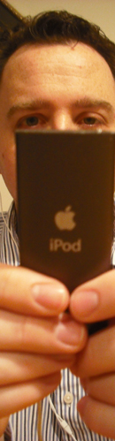
My Interests
User experience
  Learning experience
  Expression through interactive artifacts
  Issues of motivation, awareness, and
  attention in use

Slide 4
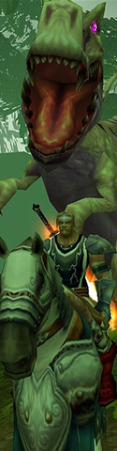
My Interests
Video Games
  Immersive qualities of games
  Learning to use and learning through games
  Serious games

Slide 5
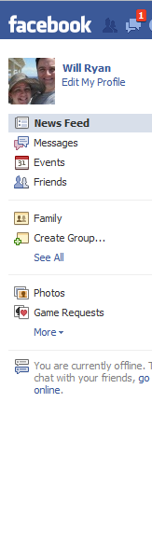
My Interests
Social media use
  Network effects on social media
  Design of social media
  Virtual communities

Slide 6
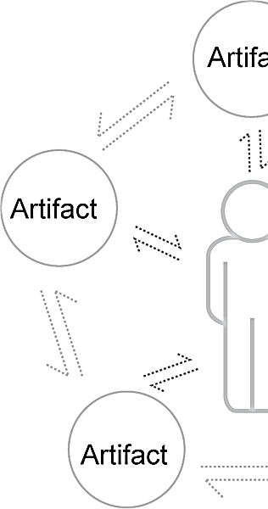
Projects
Machinima
Social & Economic Patterns in Virtual Worlds
Ecology of Artifacts
Twitterspace
Learnability of Games

Slide 7
Learning-in-use of Interactive Artifacts
Notes:
Learning: typically
Knowledge acquisition
Scope deals only when system is novel
Learning Situation
Questions this approach does not answer:
Evolving relationship with artifact (how meaning and value is derived

Slide 8

iPod Example
Notes:
Background:
I was given my iPod from my brother in the summer of 2009.
Before this, I did not have much motivation to own an iPod.
Given the opportunity to buy it cheaply, I realized there were other contexts (traveling, working out) in which I could use it more effectively than CDs.
I had a prior experience using both Apple products and iPods before, but was most familiar with Windows.
Negotiation:
There were well-defined procedures for ejecting the iPod before unplugging it
using the iPod only through iTunes to interact with devices by adding new music
Want to keep some songs my brother still had on it, but I couldn’t
Resetting a frozen iPod,
Easy to do a hard boot from most PCs for me, difficult to figure out how to do it on an iPod (not intuitive)
Realizing what content in iTunes was for my device
This was something another participant had an issue with
But also, being teased by my wife because I was painstakingly adding cover art
But it was something that I cared about doing.
Forced me to change how I interacted with it and led to a rather contentious relationship initially.
Learning-in-use required a re-orientation of my own understanding and use of the artifact.
Eventually, I began to appreciate the centrality of music that iTunes afforded me without having to rely on tracking down CDs.
I now have a habituated style of interaction with the iPod. Now, I do not have many problems that I need to resolve with the artifact on a daily basis. But at any time, I may decided to learn something new about the device.

Slide 9
History of Learning in HCI
Cogntivist
Representa-tional
Constructiv-ist
Situated
Notes:
Cogntivist
Focuses on how knowledge is created from information in the environment; and how it is encoded, stored, and retrieved.
GOMS; Information Processing Model
John; Card, Moran, Newell
Representational
Considers how a representation exerts itself in the meaning making process.
Metaphors; Affordance Theory; External Cognition; Semiotics
Carroll and Mack, Norman, Scaife and Rogers
Constructivist
Analyzes the process of meaning making beyond knowledge gained from learning, but includes analysis of how that knowledge and meaning are gained.
Active Learning
Carroll; Kay; Papert
Situated
Looks at how the situation and context act as resources in the learning process. Draws from constructivist perspective.
Learning in use; Design in use; approprition
Bodker and Petersen

Slide 10
Experiential Perspective
Experience:
occurs in a non-discrete stream over time.
is multistable.
is an internal phenomenon from external factors.
utilize adaptive processes to force equilibrium.
Is a result of a loose coupling between user and artifact.
Citations:
Dewey (1938);
Dourish (2001);
Gaver et al. (2003);
Ihde (1986);
Kolb (1984);
Sengers & Gaver
(2006);
Verbeek (2005)
Notes:
1.May be reflected upon (that is how we gain knowledge)
2. Multiple stable ways to look at and understand an artifact, depends on context.
3. Unique to the individual, have both internal and external components.
4. Changes in the environment or user selection of various contexts can disrupt the equilibrium.
5. The loose coupling allows the relationship to be redefined based on the user’s goals and the ever changing situation as well as how the artifact appears to the user.

Slide 11
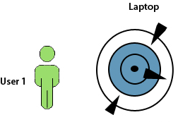
Learning-in-use
Evolves over time
Personally meaningful relationships
Negotiation through use
Citations:
Wakkary & Masteri
(2007)
Notes:
Evolve over time -> stream of time, multistability (people’s needs and situations change from one they first start using it to the last time they use it)
Personally meaningful->experiences are internal. The way one user will come to understand and find value in an artifact may be completely different than another user. Wakkery and Masteri describe the way users will appropriate objects that have other common purposes for their own everyday needs such as simple objects and features of the house (banister, mantle, and so forth).
Negotiation through use -> adaptive processes, no matter how user-friendly an artifact is their will always be some friction when I am learning something new about it. Maybe it won’t be about the interface per se, but maybe it will be about incorporating it into one’s life or dealing with certain policies the device (developer) puts in place. Kristensen?

Slide 12
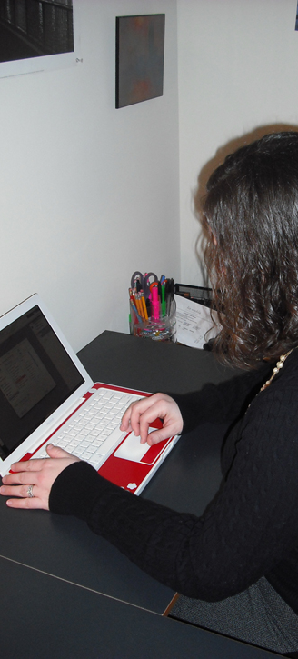
Longitudinal Study
5 month study
  2 phases
  6 interviews
12 participants
  5 female, 7 male
  4 grad, 7 undergrad, 1 staff
3 artifacts
  Photoshop
  World of Warcraft
  iPod Touch
Notes:
5-month study where participants were given artifacts that they would learn on there own time split into 2 phases of 2.5 months each (each phase participants would learn a new artifact)
We would meet up periodically to observe their progress.
Artifacts they would be given would be from among: Photoshop, World of Warcraft, and an iPod Touch
12 participants (7 male, 5 female) mix of ages and genders (though this wasn’t formally recorded). The one commonality is that they were recruited through our school’s listserv at IU Bloomington in Informatics. All had some technical knowledge and were communicated about the artifacts they could learn.
Everyone completed a 7-point likert scale about their preference for learning one of the three artifacts and experience prior to the study. The average preference for the artifacts that participants used at the beginning of the study was 5.8 out of 7, the average experience was 2.89 out of 7.
Outliers for preference (or those who rated less than 4) included P8 with WoW who rated it 2, and outliers for experience (or those who rated above 4) included P3, P4, P6, and P7 (5,5,5.5, and 5) and P3 and P6 for WoW (7, 5).

Slide 13

Methods & Analysis
Interview/observation
Longitudinal use of artifacts
Virtual Diary
Notes:
The study began by inviting participants in for an interview. There I would ask questions about past experience, initial motivation, and expectations.
I then had participants start to use the artifacts. Giving them as little direction as possible.
Photoshop users often started by opening the software, but ultimately going to Google to look for an image that inspired them that they could use in the software.
WoW users would start by making a new character and by completing some of the early quests.
iPod touch users would explore all of the different applications installed on the software, but would ultimately work their way towards the app store.
Next users needed to complete a task that should require them to use everything they had learned about the artifacts:
Photoshop users were to try to replicate the image on the screen
WoW users needed to collect as much money as they could, and buy the best piece of equipment they could.
iPod users needed to ask a question, then find, install and use an app that could help answer that question.
Finally, I asked some debriefing questions at the end of the session.
I did this 3 times per phase, for 6 interview sessions per participant
Would continue to use the artifact across sessions, they would occasionally (usually about once per week) write an entry in a virtual diary that I had setup for each participant. I would send weekly reminders to participants to add diary entries.

Slide 14
Findings
Grasping
Situating
Perceiving-in-use
Making meaning
Notes:
12 participants, 9 completed all 6 interviews
As for retention, we had 1 person stop after the second session, the other 2 stop at the final session. 25% attrition which is right on target for longitudinal studies according to Goodman and Bloom (1996) .
The total data collected:
64 hours of audio recorded
74 collected Photoshop images
72 diary entries
and hundreds of pages of notes taken.
From this data, 85 pages of data were transcribed from the audio and 24 narratives—one for each phase and each participant—were constructed.
As for their own improved abilities with the software, participants rarely changed how they viewed their own abilities on a scale of 1 to 5.
average changed the rating they gave their abilities by only 15% from the session one to session two
only 8.5% from session two to session three.
Even though their perception in their own abilities didn’t change, their relationships changed dramatically. Analyzing these changes in relationship lead to finding these four main phenomena.

Slide 15
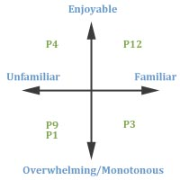
Grasping
Transition between what is familiar and what is unfamiliar.
Notes:
So much of what we do when we start to learn to use software is stick to what we know. True learning happens when we venture outside our comfort zone.
This movement between familiarity and unfamiliarity is joined by the emotional experience of learning. Sometimes it’s overwhelming, sometimes it’s challenging and enjoyable, other times it is just boring and doesn’t engage us.
This supports the two dimensions of grasping which crosses familiarity and unfamiliarity, and across this emotional bridge.

Slide 16
Grasping
R: Any new features or functions that you used today that you haven’t seen or used before?
P6: You know stuff, but you forget that you know stuff. And you are constantly making distinctions of like, “Oh, yeah, Oh yeah, that is how you do that,” so I don’t think I really learned, nothing is new, new…
R: Sort of like rediscovering some stuff?
P6: I don’t even like the term rediscovering, …but it’s like reminding.
Notes:
This user describe despite knowing how to use the software, that in use she needs to be reminded of what certain things do.
P3: Because I know what’s going on, I know what to expect, I know what I have to do. It’s kind of like going somewhere for the first time, traveling, you don’t know what to expect, there is an anticipation there. But if you have been there before, you know what to expect, you know the whole drive or flight, you know it’s going to be boring.
Find audio
This is an example where the participant describes how losing the anticipation that grasping can offer can actually sometimes leave to a very boring experience.

Slide 17
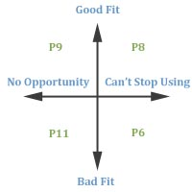
Situating
Finding the fit of this artifact into their lives, e.g., with other artifacts they owned, within their schedule, etc.
Notes:
Part of developing a meaningful relationship with the artifact is finding a place for it. This might mean a place in your schedule, or a place among the other artifacts you used. Participants need to find the right fit between the artifact and their own needs. If they didn’t, then the artifact wasn’t used very seriously and did not seem to have much of an impact on the participants.
Here the dimensions of opportunity to use came into play. Sometimes people could barely find time to use the artifact (sometimes not using it at all between sessions), and sometimes they could not stop using it, they would describe themselves being addicted. Alternatively, users could evaluate the artifact on whether or not it was a good fit for them at this current stage of their lives. Sometimes, even though they can see a value for it, when it gets down to actually using it—it doesn’t seem like quite the right fit.

Slide 18
Situating
R: What does the software allow you to do that you cannot do in any other way?
P11: Ok. Like I think I said before, I was kind of interested in it as far as my wife uses it a lot to photo edit. That was my original thought was that I might be able to help her out in the business. But, as far as that goes, it might be further questions, so. She just has certain ways she wants to do things. So, I’m just backing off on that.
Notes:
What was originally started as some way to interact with his wife, turned out to be more complicated to work into the relationship than he originally thought.

Slide 19
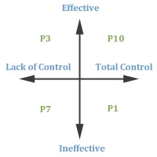
Perceiving-in-use
The way problems and activities would transform in the way they presented themselves to the participants over a lifetime of use.
Notes:
Our use of technology does not just increase our knowledge, but also enhances and augments the worlds (whether physical or digital) in which we live. Our access to information, our perception of the world around us, and the way we interact with these spaces will change when we become immersed in our artifact use. For example, when using a microscope to study some microscopic substance our attention transforms and narrows on any tasks we have in relation with understanding that microscopic substance.
Given though that this artifact gives us indirect/mediated access to a particular phenomenon in which we are interested, the artifact gains some amount of control over the situation. The perception of that control is one dimension of perceiving-in-use. This dimension defines the level of control someone believes they have over the device. The other dimension is that of the effectiveness/ineffectiveness of an artifact for delivering on it’s promise of functionality and it’s promise of such a transformation. If an artifact is claimed to be an outstanding tool for helping you create images such as Photoshop, but you have difficulty with the interface—then you will not have a high opinion of such a tool.

Slide 20
Perceiving-in-use
R: What goals do you have for using WoW and have they changed at all during the course of the study?
P9: Well, about halfway through when I was having trouble with like the missions and stuff, my goal was just to get it over with. But now, that they have made it easier, it’s more enjoyable since they basically tell you where to go for the missions. So my goal,
R: So, the latest update has made it easier?
P9: Yeah. A heck of a lot easier. So, yeah, it’s more enjoyable and easier to play now.
Notes:
This example shows how this participant how the artifact seemed very ineffective on the promise of delivering an entertaining experience. He was completing the study just because he was trying to help with the study, but he also felt a great deal of difficulty with completing the missions, missing one of the most important elements of how games like this work of understanding what you need to do, when, and where. As soon as the new patch came out, he had a great deal more control over these elements and as a result the game seemed to become more enjoyable in its own right and easier to play noting the change into an effective artifact.

Slide 21
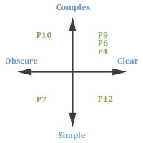
Making Meaning
Consolidating experiences and making knowledge about a situation.
Notes:
An important part of learning is making new knowledge from consolidated experience, but this is not necessarily a linear process. Often an individual must rectify inconsistencies between prior beliefs and new experiences. These experiences may contradict what a persons believes and so must make sense of what is happening in the experience.
Participant 5 using the iPod believed that he needed to pay for an OS upgrade to download all apps. What he learned during the second session was that he was looking previously only at apps designed for this new upgrade. Once he realized this, he realized that the problem he faced was different than he thought. This could be called simply a misconception, but at the same time, this assumption was made possible because of the readily accessible nature of content through the app store, which only differentiated between apps that were free and apps that cost money, not between different firmwares of iPods.
Two dimensions here are the clarity of an experience and whether an experience makes sense. This can largely be dependent on prior experience and reconciling new experiences with old experiences. The second dimension is the complexity has to do with how deep or shallow (simple or complex) an artifact is. The more you learn often times, it seems like there is more to discover.

Slide 22
Making Meaning
P12: I kind of found out about it just through interaction. And realizing that something else was going on in the game. That I hadn’t, really had the need to know about it. So, now I’m teaching other people about it all the time. I’ve taught three people in our guild. They didn’t know. They were pricing green items too low and they were pricing white items to high and they weren’t selling. You know, they just had no idea. That one guy that was using the bank vault. He basically was using the guild vault as a bank tab, because he had so much stuff. And he didn’t know. And I looked at him and I’m like, ‘Dude you could sell all this stuff, and you could probably just from everything sitting in this one tab, you could probably get 1000 gold from it.’ But he didn’t.
Notes:
I think I need to pull another part of this interview—let’s look this up—also need to fix this in chapter 4.
This example describes how one player took his experience and tried to help others learn how to use the game. There is a component of sharing information here, but this social relationship (teaching relationship) can also be instrumental in making it hard for people to leave the game. Players of a game like this start to feel committed to their guild as a result of what they can uniquely bring to how a guild works. He also reveals how he realized that something else was going on in the game, referring to the auction house. He relates that to his experience using eBay.

Slide 23
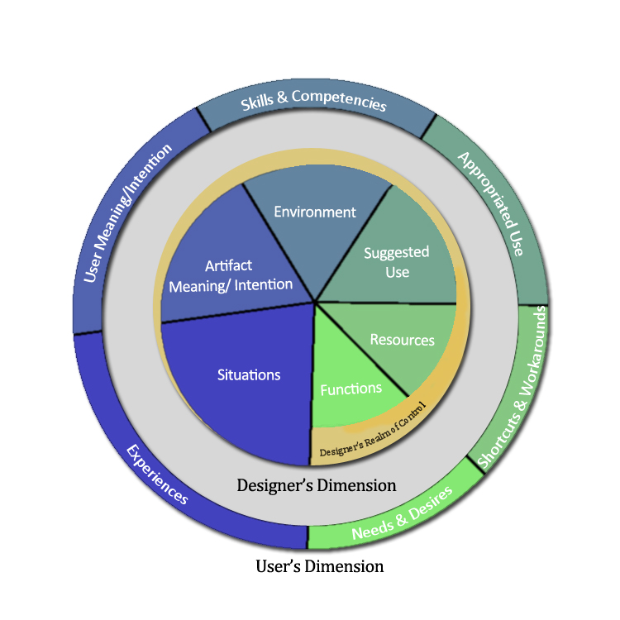
Notes:
Designer’s Dimension—that which designer’s control
Functions—How an artifact functions
Resources—Media that is instructive or meant to be used in the context of use (manual, help menu, tutorials, just-in-time help, metaphors)
Suggested Use—Officially supported ways of using an artifact
Environment—Space of possibility enacted by an interface
Artifact Intention—Meaning of an artifact as it is used, shaped by “scripts” embedded into artifact by designer
Situations—Learning opportunities in use
User’s Dimension—That which the user control’s over and which a designer only has indirect access to
Needs & Desires—What a user needs and wants from an artifact
Shortcuts & Workarounds—Understanding of an artifact acquired through use, where user does not quite understand why something works or doesn’t, but user comes up with own way of accomplishing use
Appropriated Use—describes how a user uses an artifact (whether the designer intended it or not)
Skills & Competencies—what a user brings to bear when using an artifact, what they can do with the artifact
User Intention—the personally meaningful relationships that a user has with the artifact
Experiences—Culmination of internal feelings and external interaction with the artifact in learning.
Tutorials
Needs-Functions They should be much easier to pick up, try out, evaluate, and move on to a new activity and should be easy to integrate into an overall process of use.
Resources-Workarounds Tutorials are part of a rich ecology of resources that support the learning experience. Tutorials are often the easiest way to get involved with these resources; for example, they are a great way to start becoming involved with online communities founded around an artifact. A clear line between how a tutorial is organized and how the user uses the artifact must be easy to see for user.
Suggested Use-Appropriated Use Tutorials are a teaching opportunity with a hands-on approach to learning an interface as opposed to manuals or help files. The relationship that a user forms as a result of tutorial will shape the concept of use for the user, but it will not determine it. It must provide step-by-step instructions but also allow for open-ended exploration.
Environment-Skills Tutorials are made in this way to focus on the instructive capacity of the tutorial and to draw the user’s attention to important elements. The ability to complete a tutorial may have an impact on a user’s self-efficacy and ability to use the artifact.
Artifact-User Meaning Tutorials should be similar enough to the artifact in form to orient the user in how to use the artifact, but should also transform the user in their understanding of what is possible and how that possibility can be realized.
Situations-Experiences Users have many different perspectives that they will approach using a tutorial for. Maybe as an introduction to the artifact, they are at their wits end looking for help, or they are interested in casually expanding their knowledge of a system. This means that tutorials must empower the user “with ease” regardless of their level of experience and perspective.

Slide 24
Contribution
Conceptual development of learning-in-use
Framework
Experiential approach
Citations:
Button (2003);
Button & Dourish
(1996);
Dourish (2001);
Forlizzi & Ford
(2000);
Gaver et al. (2007);
McCarthy & Wright
(2004);
Sengers & Gaver
(2006);
Winograd & Flores
(1986)
Notes:
I have talked at length about the other two, but I also want to talk about the benefits and limitations of the experiential approach.
It is a perspective in use in HCI/interaction design currently, but as far as I could find in the literature it has never been applied to how people learn how to use interactive artifacts.
Allows for the examination and analysis of deep, latent, intentional structures and relationships that emerge through use.
Allows for the co-construction of knowledge and meaning between researcher and subject intersubjectively. Users can share their meaning with the researcher and the researcher can then also share their understanding back with the user either aligning or not with their experience.
Limitations:
It works with subjectivity (albeit in an objective way), because of the focus on experience. This means this can limit the generalizability of this perspective as much as other perspectives might be able to account for.
It is very high in its resource consumption. Often, we need to allow for a broad length of time to pass, we often want to collect a broad array of experiences and this could be more time consuming both in terms of study implementation and analysis than other approaches even if experiential studies are not longitudinal. This makes this approach difficult to do in practice. Researchers in this approach must have a level of experience with this methodology to use it effectively. This could be said of any approach, but while there are many researchers competent in methods of survey research and experimental research, there are far less who can effectively perform ethnography or phenomenology.
Nonetheless, it offers a unique insight into the learning experience and should have a place amongst the different perspectives mentioned earlier.

Slide 25
Future Work
Hypothesis #1:
  People are more comfortable and more likely to engage in learning when an artifact is more familiar in general, and less comfortable and less likely to engage in learning when an artifact is less familiar.
Research Question #1:
  How do the four phenomena of learning-in-use play out for user’s own actual artifacts?
Research Question #2:
  How effectively can designers influence learning-in-use?
Notes:
From the study, a certain base level of comfort aids users both in learning something new about an artifact and in deepening their relationship with the artifact. An experimental approach coupled with a battery of questions on the users level of comfort, confidence in their abilities, and familiarity with an artifact could help identify the roles these factors play.
Focus on users own artifacts as opposed to the one I give them, even if they were motivated to learn and use them. Are there any differences? Was this study too artificial?
The role they played in the study was mentioned most frequently when users explained why they did not find much use for the artifacts in the study. Also, there could possibly some unmentioned positive influence that other artifacts have in the use of a particular artifact.
I would like to look further into what tools and techniques designers have to address situations of learning-in-use given they can only effect it indirectly. How does it relate to the tools and techniques to address situations of learning as knowledge acquisition? What are the implications for trying to influence the way users learn-in-use?

Slide 26
Broad Research Goal
Empirical and theoretical contributions:
  Learning-in-use
  Immersion/engagement
  Motivation
  Attention and awareness in use
  Breakdown
How does technology enable meaning-in-use?
  Relating functional design with experience
  Is there a relationship
Notes:
Part two:
How does social media permit the distribution of, dissemination of, and forum for learning and shared, intersubjective social experience?
How can games be used to make learning or information dissemination meaningful?
How do games become so engaging?

Slide 27
Questions?

Slide 29
Supplemental Slides
Research Questions Sample Questions

Slide 30
Sample Interview Questions: Past Experience
Have you used Photoshop or other software before? (which)
  How long ago and for how long?
  What did you most commonly use this software for? (in what contexts)
  What did you make with this software (description)?
What reasons did you have for using these programs in the past?
Has using these programs been easy /hard for you in the past?
Did you ever have any problems with the software? If so, please explain?

Slide 31
Questions: Expectations
First, how do you expect (Photoshop, World of Warcraft, or this iPod Touch) to be useful for you?
What kind of tasks or activities do you foresee using this device for?
Without having used it, what do you need to do in order to accomplish these tasks?
Do you foresee any obstacles that will hinder your use of the system?
Where do you think you will go to for help with the system when you get stuck with it?
How strongly would you rate your ability to use this device before using it? On a scale of 1 (lowest) to 5 (highest).
What is the likelihood that you will be able to use the device to accomplish all of your important goals? On a scale of 1 to 5.
Do you feel that you will be in control of the technology? How so?

Slide 32
Questions: Motivations
What goals do you have for using the device?
What aspects of the device do you expect to find most enjoyable?
What motivates you to use this device?

Slide 33
Research Questions
How do users learn to use interactive artifacts?
In particular, how does their understanding of use evolve through different prior experiences, contexts of use, resources, motivations, or uses of functionalities?
How is this understanding stable over time and in what ways does it change?
Notes:
As mentioned, this first question has been dealt with extensively in HCI. But I aim to take this in a renewed direction basing this direction on how users derive meaning and value in an artifact as part of the grounds by which learning takes place.
The second question starts to address some of the factors both internal and external that I aimed to understand in the context of the learning experience and their influence. I was also open to new factors to emerge in importance.
This third question sought to understand how those individual negotiations that a user must make with the artifact will over time shift a user through various local maxima and minimas of use and experience. This question anticipates to some extent the shifting external factors in a person’s life, the internal factors such as goals and motivations, and the multistability of experience.

Slide 34
Review Research Questions
How do users learn to use interactive artifacts?
In particular, how does their understanding of use evolve through different prior experiences, contexts of use, resources, motivations, or uses of functionalities?
How is this understanding stable over time and in what ways does it change?

Slide 35
References
Bødker, S., & Petersen, M. (2000). Design for learning in use. Scandinavian Journal of Information Science, 12, 61-80.
Button, G. (2003). Studies of work in Human-Computer Interaction. In J. M. Carroll (Ed.), HCI Models, Theories, and Frameworks: Toward a Multidisciplinary Science. San Francisco: Morgan Kaufmann Publishers. pp. 357-380.
Button, G., & Dourish, P. (1996). Technomethodology: Paradoxes and possibilities. In Proceedings of CHI ’96, Vancouver, Canada, 19-26.
Card, S., Moran, T. P., & Newell, A. (1983). The Psychology of HumanComputer Interaction. Hillsdale, NJ: Lawrence Erlbaum Associates, Inc.
Carroll, J. M. (1990). The Nurnberg Funnel: Designing Minamalist Instruction for Practical Computer Skill. Cambridge: MIT Press.
Dewey, J. (1938). Experience & Education. New York: Touchstone.
Dourish, P. (2001).Where the Action Is: The Foundations of Embodied Interaction. Cambridge, MA: MIT Press.

Slide 36
References
Gaver, W. W., Beaver, J., & Benford, S. (2003). Ambiguity as a Resource for Design. In Proceedings of CHI 2003, Ft. Lauderdale, FL, 233-240.
Gaver, W., Sengers, P., Kerridge, T., Kaye, J., & Bowers, J. (2007). Enhancing ubiquitous computing with user interpretation: Field testing the home health horoscope. In Proceedings of CHI 2003, San Jose, CA, 537-546.
Ihde, D. (1986). Experimental Phenomenology: An Introduction. Albany, NY: SUNY Press.Kolb, D. A. (1984). Experiential Learning: Experience as the Source of Learning and Development. Englewood Cliffs, NJ: Prentice Hall, Inc.
John, B. E. (2003). Information processing and skilled behavior. In J. M. Carroll (Ed.), Toward a Multidisciplinary Science of Human Computer Interaction. San Francisco: Morgan Kaufmann Publishers. pp. 55-101.
Kay, A. (1990). User interface: A personal view. In B. Laurel (Ed.), The Art of Human-Computer Interface Design, Reading, MA: Addison-Wesley, pp. 191-207.
McCarthy, J., & Wright, P., (2004). Technology As Experience. Cambridge, MA: MIT Press.

Slide 37
References
Norman, D. (2002). The Design of Everyday Things. New York: Basic Books.
Papert, S. (1980). Mindstorms. New York: Basic Books.
Petersen, M. G. (2002). Designing for Learning in Use of Everyday Artefacts. Ph.D. Thesis. University of Aarhus, Denmark.
Scaife, M., & Rogers, Y. (1996). External cognition: How do graphical representations work? Int. Jour. Human-Computer Studies, 45, 185-213.
Sengers, P., & Gaver, B. (2006). Staying open to multiple interpretations: Engaging multiple meanings in design and evaluation. In Proceedings of DIS ’06. 99-108.
Verbeek, P.-P. (2005). What Things Do. Philosophical Reflections on Technology, Agency, and Design. State College, PA: Penn State Press.
Wakkary, R., & Maestri, L. (2007). The resourcefulness of everyday design. C&C ’07, 163-172,
Winograd, T., & Flores, F. (1986). Understanding Computers and Cognition: A New Foundation for Design. Norwood, NJ: Ablex Publishing.

Slide 38
Image References
http://www.williamryanonline.net/images/me.jpg
http://www.geology.iupui.edu/Resources/Support/IUPUI-logo/logos/IUPUI_color_trans.gif
http://1.bp.blogspot.com/_K3_JHYgrx7U/SwffiMtrzAI/AAAAAAAAAOA/fbOlRPxNn2Q/s1600/NotreDame_Logo3.jpg
http://www.courier-journal.com/blogs/demling/uploaded_images/IU_logo-701390.jpg
Jung, H., Stolterman, E., Ryan, W., Stroman, T., & Siegel, M. (2008). Toward a framework for ecology of artifacts: How are artifacts interconnected surrounding a personal life? In Proceedings of 5th Nordic Conference on Human-Computer Interaction. 201-210. Lund, Sweden.

Slide 39
Image References
Ryan, W., Hazlewood, W. R., & Makice, K. (2008). Twitterspace: Co-development through Twitter to enhance community awareness. In Proceedings of Participatory Design Conference 2008, 230-233, Bloomington, IN.
http://www.ratemyscreensaver.com/wp-content/uploads/2008/02/windowslivewriterworldofwarcraftpart4-d3d1ss02622.jpg
Facebook
Card, S., Moran, T. P., & Newell, A. (1983). The Psychology of HumanComputer Interaction. Hillsdale, NJ: Lawrence Erlbaum Associates, Inc.
http://4.bp.blogspot.com/_DBdwDaB4fM0/TIcn_ys_hoI/AAAAAAAABCg/TQthkoHnw-k/s1600/switches.png
http://hackedgadgets.com/wp-content/_Lego%20Mindstorms%20NXT_3.jpg
http://www.officechairadvice.com/images/assets/reviews/bailey-in-office-setting-large.jpg

